Slide 1
UNIT-1
INTRODUCTION TO INTERNET OF THINGS

Slide 2
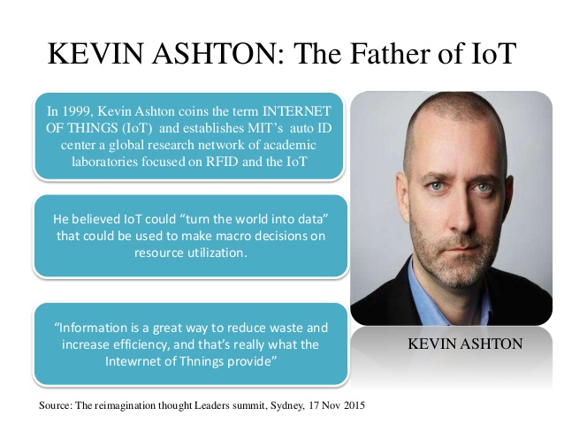
History of IoT

Slide 3

History of IOT
1999- The term "Internet of Things" was used by Kevin Ashton during his work at P&G which became widely accepted
2004 - The term was mentioned in famous publications like the Guardian, Boston Globe, and Scientific American
2005-UN's International Telecommunications Union (ITU) published its first report on this topic.
2008- The Internet of Things was born
2011- Gartner, the market research company, include "The Internet of Things" technology in their research

Slide 4
TOPICS TO BE COVERED
Definition
Characteristics of IoT
Challenges and Issues
Physical Design of IoT
Logical Design of IoT - IoT Functional Blocks
Security

Slide 5
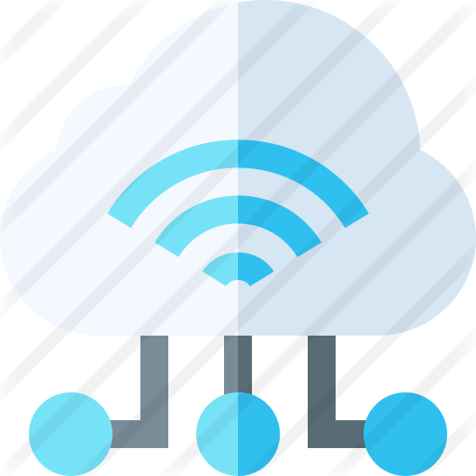
What is the internet of things (IoT)?
“The Internet of Things (IoT) is a system of interrelated
computing devices, mechanical and digital machines,
objects, animals or people that are provided with
unique identifiers and the ability to transfer data
over a network without requiring human-to-human or
human-to-computer interaction.”
The internet of things, or IoT, is a system of interrelated , Internet-connected objects which are able to collect and transfer data over a wireless network without human intervention.
For ex: smart fitness bands or watches, drivers, cars or drones, smart homes that can be unlocked through smart phones and smart cars etc..

Slide 6
What is the internet of things (IoT)?
The internet of things, or IoT, is a system of interrelated computing devices, mechanical and digital machines, objects, animals or people that are provided with unique identifiers (UIDs) and the ability to transfer data over a network without requiring human-to-human or human-to-computer interaction.
A thing in the internet of things can be a person with a heart monitor implant, a farm animal with a biochip transponder, an automobile that has built-in sensors to alert the driver when tire pressure is low or any other natural or man-made object that can be assigned an Internet Protocol (IP) address and is able to transfer data over a network.
Increasingly, organizations in a variety of industries are using IoT to operate more efficiently, better understand customers to deliver enhanced customer service, improve decision-making and increase the value of the business.

Slide 7
How does IoT work?
An IoT ecosystem consists of web-enabled smart devices that use embedded systems, such as processors, sensors and communication hardware, to collect, send and act on data they acquire from their environments.
IoT devices share the sensor data they collect by connecting to an IoT gateway or other edge device where data is either sent to the cloud to be analyzed or analyzed locally. Sometimes, these devices communicate with other related devices and act on the information they get from one another.
The devices do most of the work without human intervention, although people can interact with the devices.

Slide 8
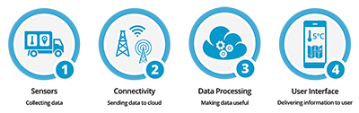
1) Sensors/Devices
2) Connectivity
3) Data Processing
4)User Interface

Slide 9
Sensors in even the holy cow!
In the world of IoT, even the cows will be connected and monitored. Sensors are implanted in the ears of cattle. This allows farmers to monitor cows’ health and track their movements, ensuring a healthier, more plentiful supply of milk and meat for people to consume. On average, each cow generates about 200 MB of information per year.

Slide 10
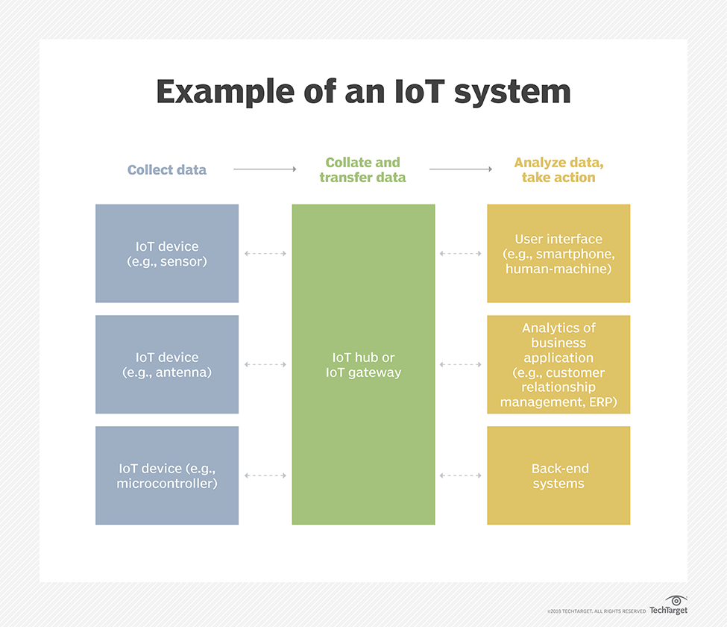

Slide 11
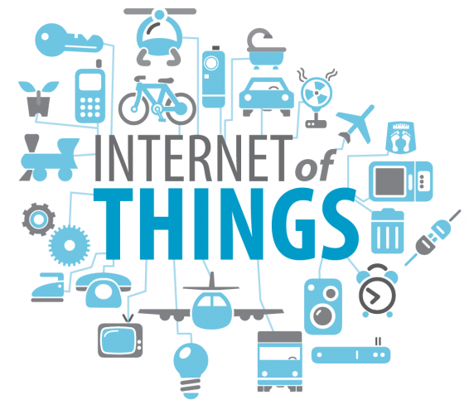
Applications of IoT

Slide 12
Few Applications of IoT
Building and Home automation
Manufacturing
Medical and Healthcare systems
Media
Environmental monitoring
Infrastructure management
Energy management
Transportation
Better quality of life for elderly

Slide 13
Characteristics of Internet of Things:
According to the definition of internet of things (IoT), there are lot of IoT devices which are interconnected with each through internet. These devices sense the data continuously from their environment. Sensed data can either share with each other or transmitted on cloud server.
Major Characteristics of the Internet of Things:
There are the following characteristics of IoT as follows. Let’s discuss it one by one.
1. Connectivity :
Connectivity is an important pillar of the IoT infrastructure. IoT devices should be connected regardless of their presence. Without connection, nothing makes sense.
2. Identity :
Each IoT device has its unique identity. If it needs to access the data from specific device then its identification element is very helpful.

Slide 14
3. Intelligence
The extraction of data from the sensor devices is very important. This data is only useful if it is interpreted properly. IoT perform operations on sensed data in such a way that the results are useful for us. It is the intelligence property of IoT.
4. Scalability
The number of IoT devices are increasing day by day. Hence, the scalability of an IoT should be enough that it can handle the massive traffic.
5. Dynamic and Self-Adapting
IoT devices should dynamically adapt themselves according to situations. For example a camera can capture data according to light conditions. It is shifted to night or day mode automatically. It is self-Adapting technique

Slide 15
6. Architecture
IoT architecture should be hybrid, supporting different manufacturers. So, it cannot be homogeneous in nature. IoT is not the name of any engineering branch. IoT comes to picture when multiple domains come together.
7. Safety
Safety should be the top priority. But in case of IoT, Safety is big challenge because multiple things are connected through internet. And security at each node is a critical and tough task.

Slide 16
Architecture of IoT:
There are different phases in the architecture of IoT but they can vary according to the situations but generally, there are these four phases in the architecture of IoT
Networked Devices
These are the physical devices which include sensors, actuators, and transducers. These are the actual devices that collect and send the data for processing. They are capable of receiving real-time data and they can convert the physical quantities into electrical signals which can be sent through a network.
Data Aggregation
It is a very important stage as it includes converting the raw data collected by sensors into meaningful data which can be used to take actions. It also includes Data Acquisition Systems and Internet Gateways. It converts the Analog signals provided by sensors into digital signals.

Slide 17
Final Analysis
This is a stage that includes edge IT analytics and the processing of data to make it more efficient and fully capable of execution. It also includes managing and locating all the devices correctly
Cloud Analysis
The final data is received here and analysed closely and precisely in data centres. They process and clean the data to make it free from any kind of errors and missing values. After this stage, data is ready to be sent back and executed to perform operations.
Now let us see the basic fundamental architecture of IoT which consists of four stages as shown in the diagram given below

Slide 18
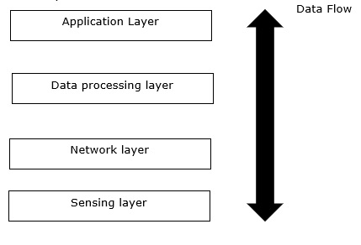

Slide 19
Sensing Layer − The first stage of IoT includes sensors, devices, actuators etc. which collect data from the physical environment, processes it and then sends it over the network.
Network Layer − The second stage of the IoT consists of Network Gateways and Data Acquisition Systems. DAS converts the analogue data (collected from Sensors) into Digital Data. It also performs malware detection and data management.
Data Processing Layer − The third stage of IoT is the most important stage. Here, data is pre-processed on its variety and separated accordingly. After this, it is sent to Data Centres. Here Edge IT comes into use.
Application Layer − The fourth stage of IoT consists of Cloud/Data Centres where data is managed and used by applications like agriculture, defence, health care etc.

Slide 20
Advantages
The advantages of IoT are as follows −
Cost Reduction − IOT devices catch any problem very fast as compared to traditional troubleshooting. It not only saves time but also saves costs of large repairs.
Efficiency and Productivity − An automated PDF conversion and creation tool will remove the hustle of PDF editing and archiving. Hence, increase in Efficiency and Productivity.
Business Opportunities − IOT provides advanced analytics, smart utility grids which help Small Management Businesses to provide more valuable content and things to their customers.
Customer Experience − Nowadays customer's experience is the most valuable thing in running a business. IoT has drastically increased the customer's experience. An example of customer experience is Home Automation. Since everything is connected, customers need not have to worry about appliances. One can turn off the appliance through mobile.
Mobility and Agility − With the help of IoT, employees can do their work from any geographical location, anytime without any restrictions.

Slide 21
Disadvantages
The disadvantages of IoT are as follows −
Security − The data is travelling all over the Internet. So maintaining its privacy is still a Big Challenge. End-to-end Encryption is a must in IoT.
Compatibility − There is no International Standard for the monitoring of the equipment.
Complexity − Most of the devices still contain some software bugs. Each device must be able to seamlessly interact with other devices in the network.
Safety − Suppose a patient is left unattended by a doctor. And some notorious guy changes the prescription or Health monitoring devices malfunctioned. Then it can result in the death of the patient.
Policies − Government authorities must take some steps to make policies and standards related to IoT to stop the Black marketing of IoT devices.

Slide 22
The technologies supported by IoT are as follows −
Big Data Analytics
Cloud
Wireless Sensor Networks
Embedded Systems
5 Layer Architecture of IoT : When project work is done with various cutting edge technologies and broad application area, 5 layer architecture is considered as best. 5 Layer model can be considered as an extension to the basic architecture of IoT because it has two additional layers to the basic model.

Slide 23
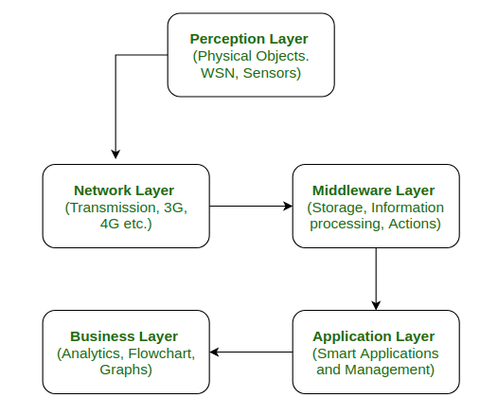

Slide 24
Perception Layer : This is the first layer of IoT architecture. In the perception layer, number of sensors and actuators are used to gather useful information like temperature, moisture content, intruder detection, sounds, etc. The main function of this layer is to get information from surroundings and to pass data to another layer so that some actions can be done based on that information.
Network Layer : As the name suggests, it is the connecting layer between perception and middleware layer. It gets data from perception layer and passes data to middleware layer using networking technologies like 3G, 4G, UTMS, WiFI, infrared, etc. This is also called communication layer because it is responsible for communication between perception and middleware layer. All the transfer of data done securely keeping the obtained data confidential.

Slide 25
Middleware Layer : Middleware Layer has some advanced features like storage, computation, processing, action taking capabilities. It stores all data-set and based on the device address and name it gives appropriate data to that device. It can also take decisions based on calculations done on data-set obtained from sensors.
Application Layer : The application layer manages all application process based on information obtained from middleware layer. This application involves sending emails, activating alarm, security system, turn on or off a device, smartwatch, smart agriculture, etc.
Business Layer : The success of any device does not depend only on technologies used in it but also how it is being delivered to its consumers. Business layer does these tasks for the device. It involves making flowcharts, graphs, analysis of results, and how device can be improved, etc.

Slide 26
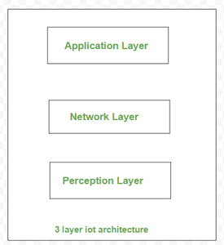
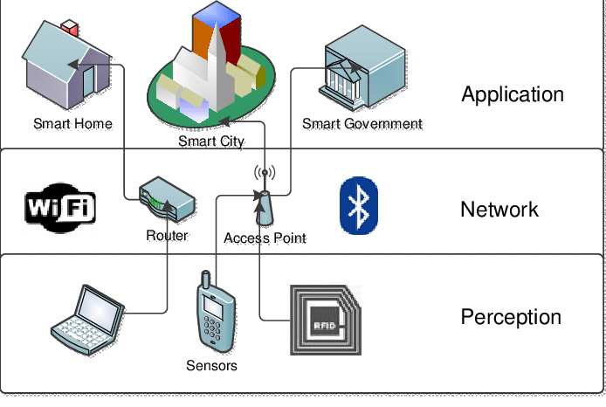
Three layer architecture:

Slide 27
CHALLENGES AND ISSUES
Mobility
Reliability
Scalability
Management
Availability
Interoperability

Slide 28
Mobility
Most of the IoT devices are mobile and hence they have a dynamic topology. Their IP address change based on the network and location. Routing protocols need to be adaptive to the changes in the network topology. If the mobility results in change of the service provider, the complexity further increases.
Reliability
IoT applications require devices to be more reliable and should respond to the changing environment rapidly and should communicate reliably. This is very crucial as a wrong information can lead to disastrous scenarios.

Slide 29
Scalability
The scalability is the biggest challenge in IoT network. As the number of connected devices in the network increases, managing the devices and their distribution becomes difficult. Accommodating services to the newly joined devices is also a tedious task.
Management
Management involves Faults, Configuration, Accounting, Performance and Security (FCAPS)aspects of all the devices.
Availability
Availability is another factor of prime importance. The device should be available both in terms of software (services provided) and hardware (accessibility to other devices, compatibility with existing IoT functionalities and protocols)

Slide 30
Interoperability
Heterogeneity is the key attribute to the IoT network. With devices with different hardware platforms, operating systems, interoperability is the major issue of concern in IoT.

Slide 31
PHYSICAL DESIGN OF IoT
Physical Devices (Things in IoT)
IoT Protocols

Slide 32
PHYSICAL DESIGN OF IoT
Physical Devices (Things in IoT)
The IoT uses various sensors and actuators to control the environment in which it is installed. These sensors may be on-board or attached. These sensors collect information from the external world and may store this data in local memory or in a cloud for analysis. The actuators are operated based on the commands sent over the internet.
The things may be automobiles, wearable devices (fitness band)

Slide 33
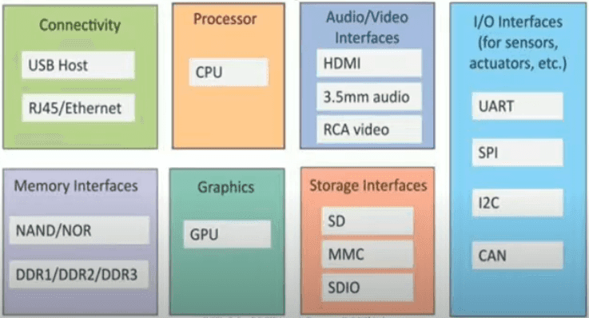

Slide 34
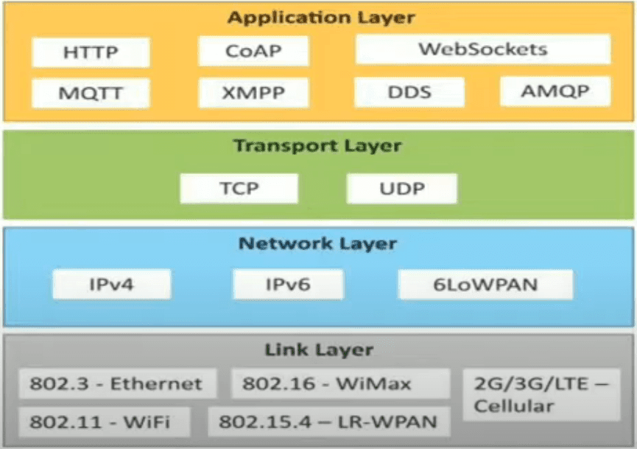
IoT Protocols:

Slide 35
These protocols are used to establish communication between a node device and a server over the internet. it helps to send commands to an IoT device and receive data from an IoT device over the internet. we use different types of protocols that are present on both the server and client-side and these protocols are managed by network layers like application, transport, network, and link layer.
Application Layer protocol
In this layer, protocols define how the data can be sent over the network with the lower layer protocols using the application interface. these protocols include HTTP, WebSocket, XMPP, MQTT, DDS, and AMQP protocols.
HTTP
Hypertext transfer protocol is a protocol that presents in an application layer for transmitting media documents. it is used to communicate between web browsers and servers. it makes a request to a server and then waits till it receives a response and in between the request server does not keep any data between two requests.

Slide 36
WebSocket
This protocol enables two-way communication between a client and a host that can be run on an untrusted code in a controlled environment. this protocol is commonly used by web browsers.
MQTT
It is a machine-to-machine connectivity protocol that was designed as a publish/subscribe messaging transport. and it is used for remote locations where a small code footprint is required.
Transport Layer
This layer is used to control the flow of data segments and handle the error control. also, these layer protocols provide end-to-end message transfer capability independent of the underlying network.
TCP
The transmission control protocol is a protocol that defines how to establish and maintain a network that can exchange data in a proper manner using the internet protocol.

Slide 37
UDP
a user datagram protocol is a part of an internet protocol called the connectionless protocol. this protocol is not required to establish the connection to transfer data.
Network Layer
This layer is used to send datagrams from the source network to the destination network. we use IPv4 and IPv6 protocols as host identification that transfers data in packets.
IPv4
This is a protocol address that is a unique and numerical label assigned to each device connected to the network. an IP address performs two main functions host and location addressing. IPv4 is an IP address that is 32-bit long.
IPv6
It is a successor of IPv4 that uses 128 bits for an IP address. it is developed by the IETF task force to deal with long-anticipated problems.

Slide 38
Link Layer
Link-layer protocols are used to send data over the network's physical layer. it also determines how the packets are coded and signaled by the devices.
Ethernet
It is a set of technologies and protocols that are used primarily in LANs. it defines the physical layer and the medium access control for wired ethernet networks.
WiFi
It is a set of LAN protocols and specifies the set of media access control and physical layer protocols for implementing wireless local area networks.

Slide 39
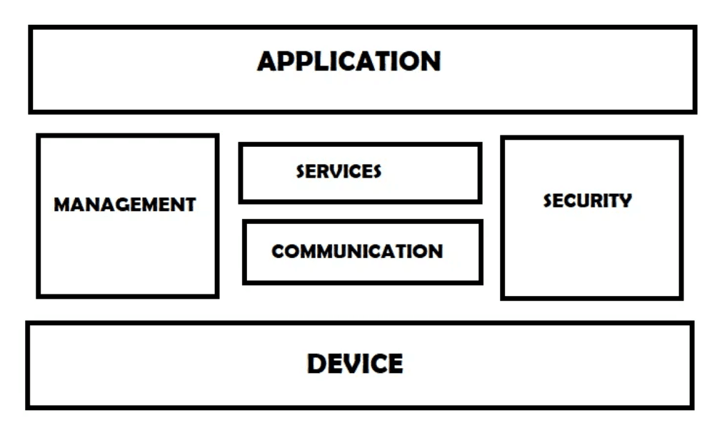
IoT Functional blocks

Slide 40
An IoT system consists of a number of functional blocks like Devices, services, communication, security, and application that provide the capability for sensing, actuation, identification, communication, and management.
These functional blocks consist of devices that provide monitoring control functions, handle communication between host and server, manage the transfer of data, secure the system using authentication and other functions, and interface to control and monitor various terms.
Application
It is an interface that provides a control system that use by users to view the status and analyze of system.
Management
This functional block provides various functions that are used to manage an IoT system.

Slide 41
Services
This functional block provides some services like monitoring and controlling a device and publishing and deleting the data and restoring the system.
Communication
This block handles the communication between the client and the cloud-based server and sends/receives the data using protocols.
Security
This block is used to secure an IoT system using some functions like authorization, data security, authentication, 2-step verification, etc.
Device
These devices are used to provide sensing and monitoring control functions that collect data from the outer environment.

Slide 42
SECURITY:
Security is another aspect of IoT applications which is critical and can be found in all almost all layers of the IoT protocols. Threats exist at all layers including data link, session, and application layers.
Data Link Layer Security
MAC 802.15.4 offers different security modes by utilizing the “Security Enabled Bit” in the Frame Control field in the header. Security requirements include confidentiality, Authentication, integrity, access control mechanisms and secured Time-Synchronized Communications.
Network Layer
RPL offers support for data authenticity, semantic security, protection against replay attacks, confidentiality and key management.
Application layer
Applications can provide additional level of security using TLS or SSL as a transport layer protocol. In addition, end to end authentication and encryption algorithms can be used to handle different levels of security as required.

Slide 43
IoT COMMUNICATION MODELS
Request – Response Model
Publish-Subscribe model
Push-Pull Model
Exclusive-Pair model

Slide 44
Push-Pull Model

Slide 45
Exclusive Pair Model

Slide 46
IoT COMMUNICATION APIs
RESTFul API
WEBSOCKETS
WEBSOCKETS
Restful API
WEBSOCKETS

Slide 47
IoT COMMUNICATION APIs: RESTFul

Slide 48
Separation allows client and server to be independently developed and updated.
Stateless: Each request from client to server must contain all the info. Necessary to understand the request, and cannot take advantage of any stored context on the server.
Cache-able: Cache constraint requires that the data within a response to a request be implicitly or explicitly labelled as cache-able or non-cacheable. If a response is cache-able, then a client cache is given the right to reuse that response data for later, equivalent requests.
Layered System: constraints the behaviour of components such that each component cannot see beyond the immediate layer with which they are interacting.
User Interface: constraint requires that the method of communication between a client and a server must be uniform.
Code on Demand: Servers can provide executable code or scripts for clients to execute in them context. This constraint is the only one that is optional.
Request-Response model used by REST:
RESTful web service is a collection of resources which are represented by URIs. RESTful web API has a base URI. The clients and requests to these URIs using the methods defined by the HTTP protocol (e.g.: GET, PUT, POST or DELETE). A RESTful web service can support various interfaces

Slide 49
Request – Response Model

Slide 50
WEBSOCKETS

Slide 51
END OF UNIT - 1

